Slide 1
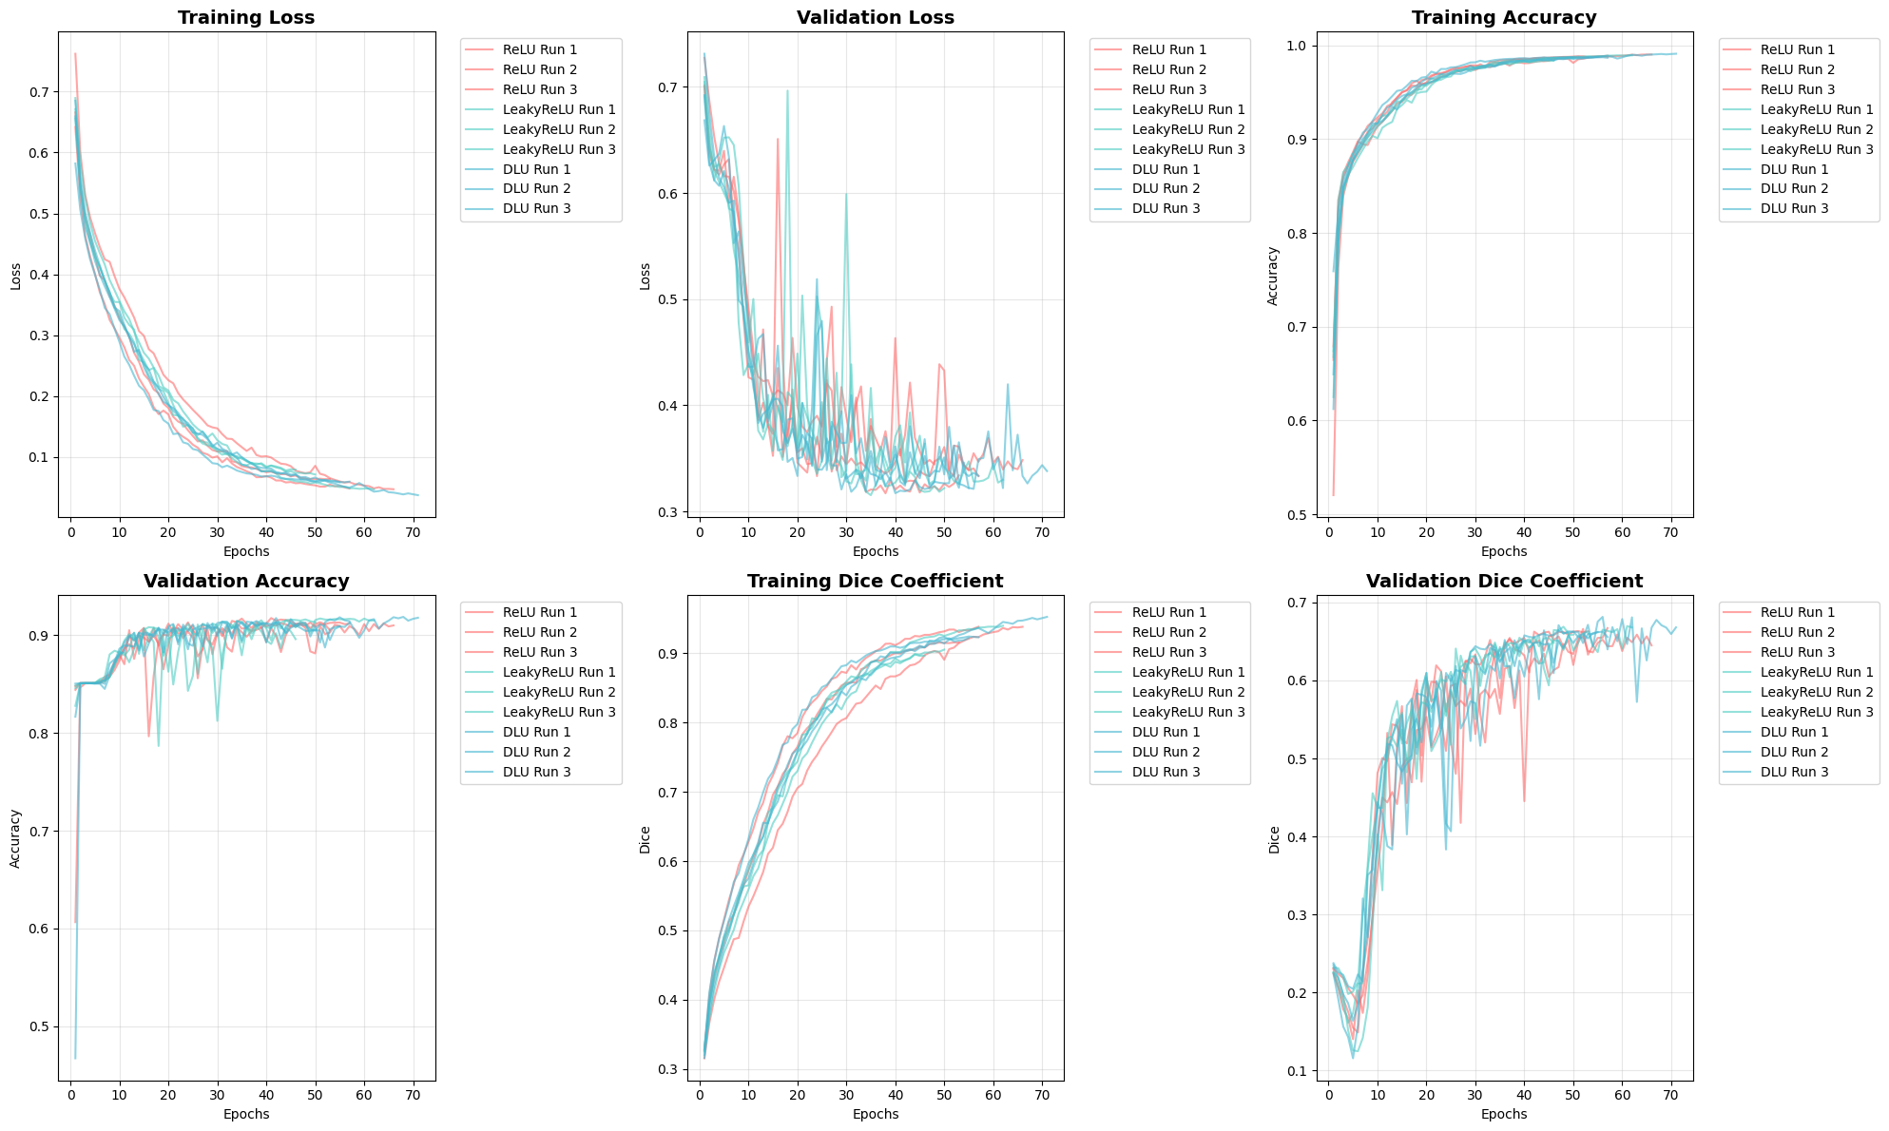

Slide 2
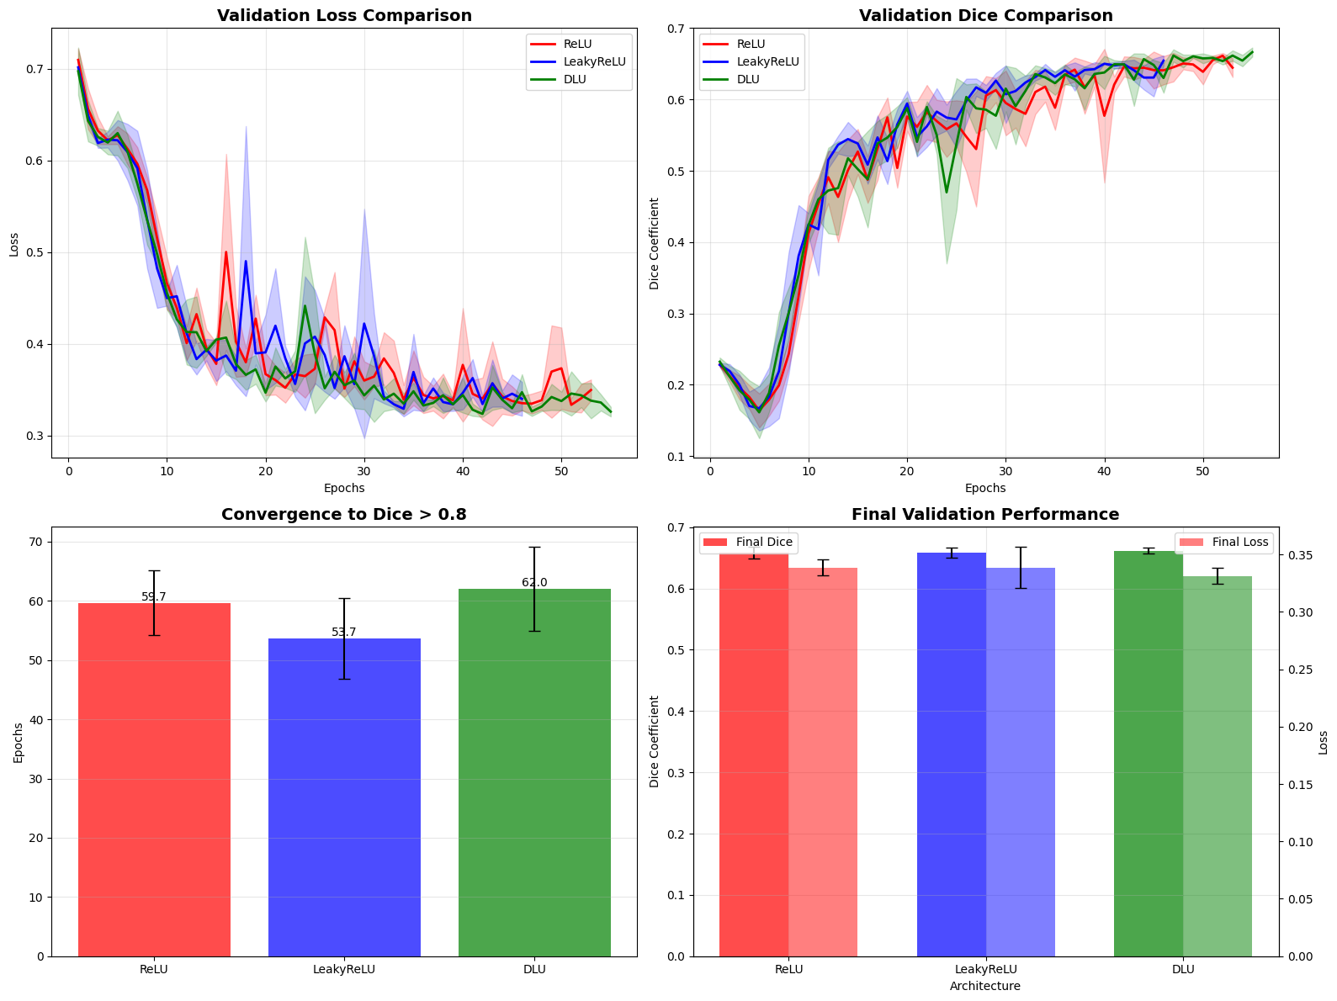

Slide 3
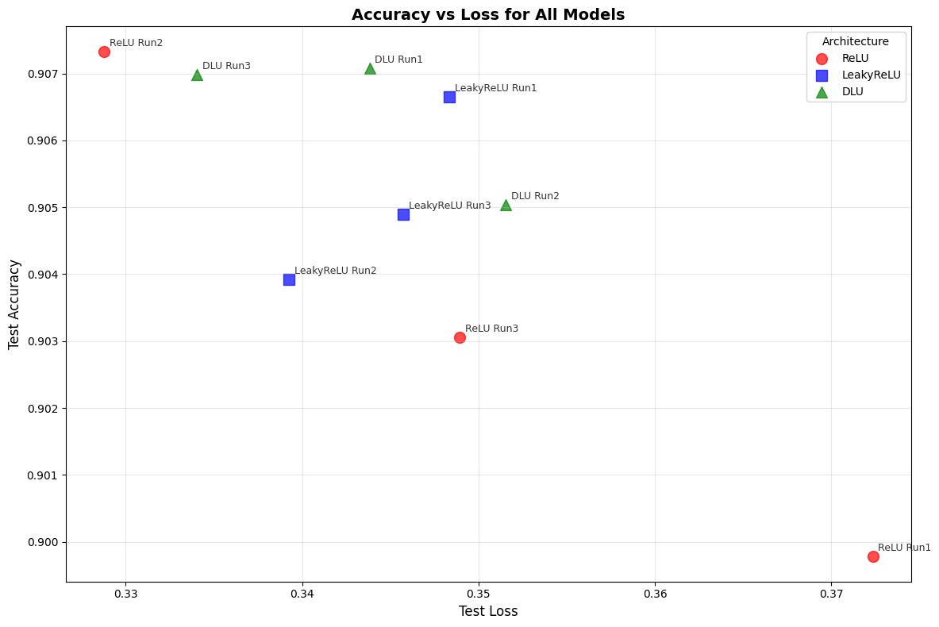

Slide 4
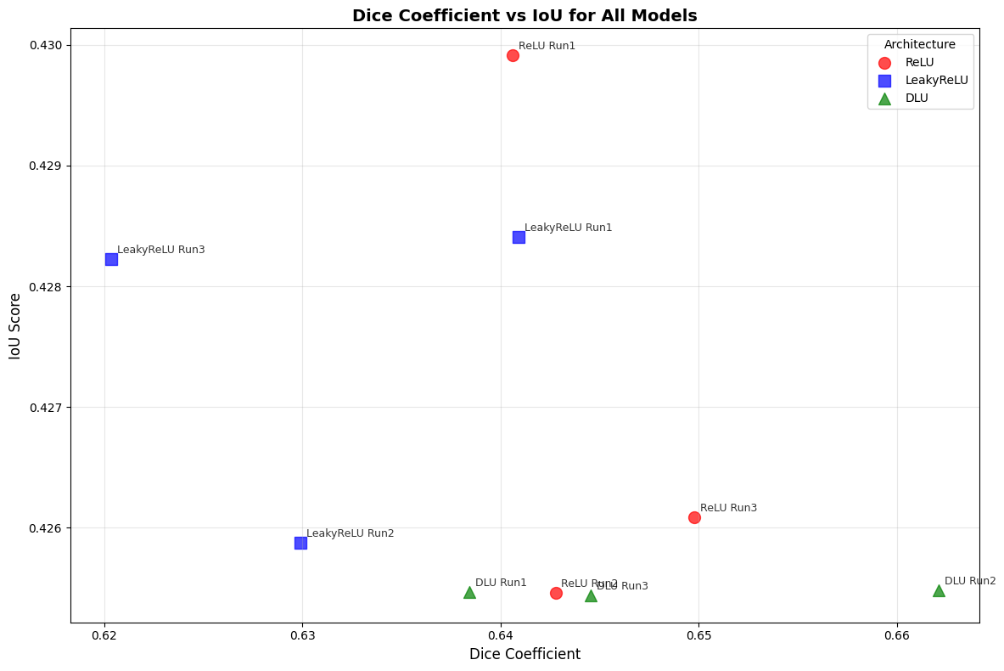

Slide 5
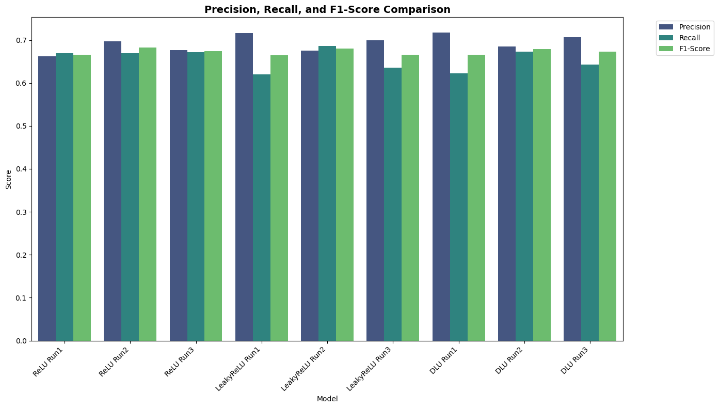

Slide 6
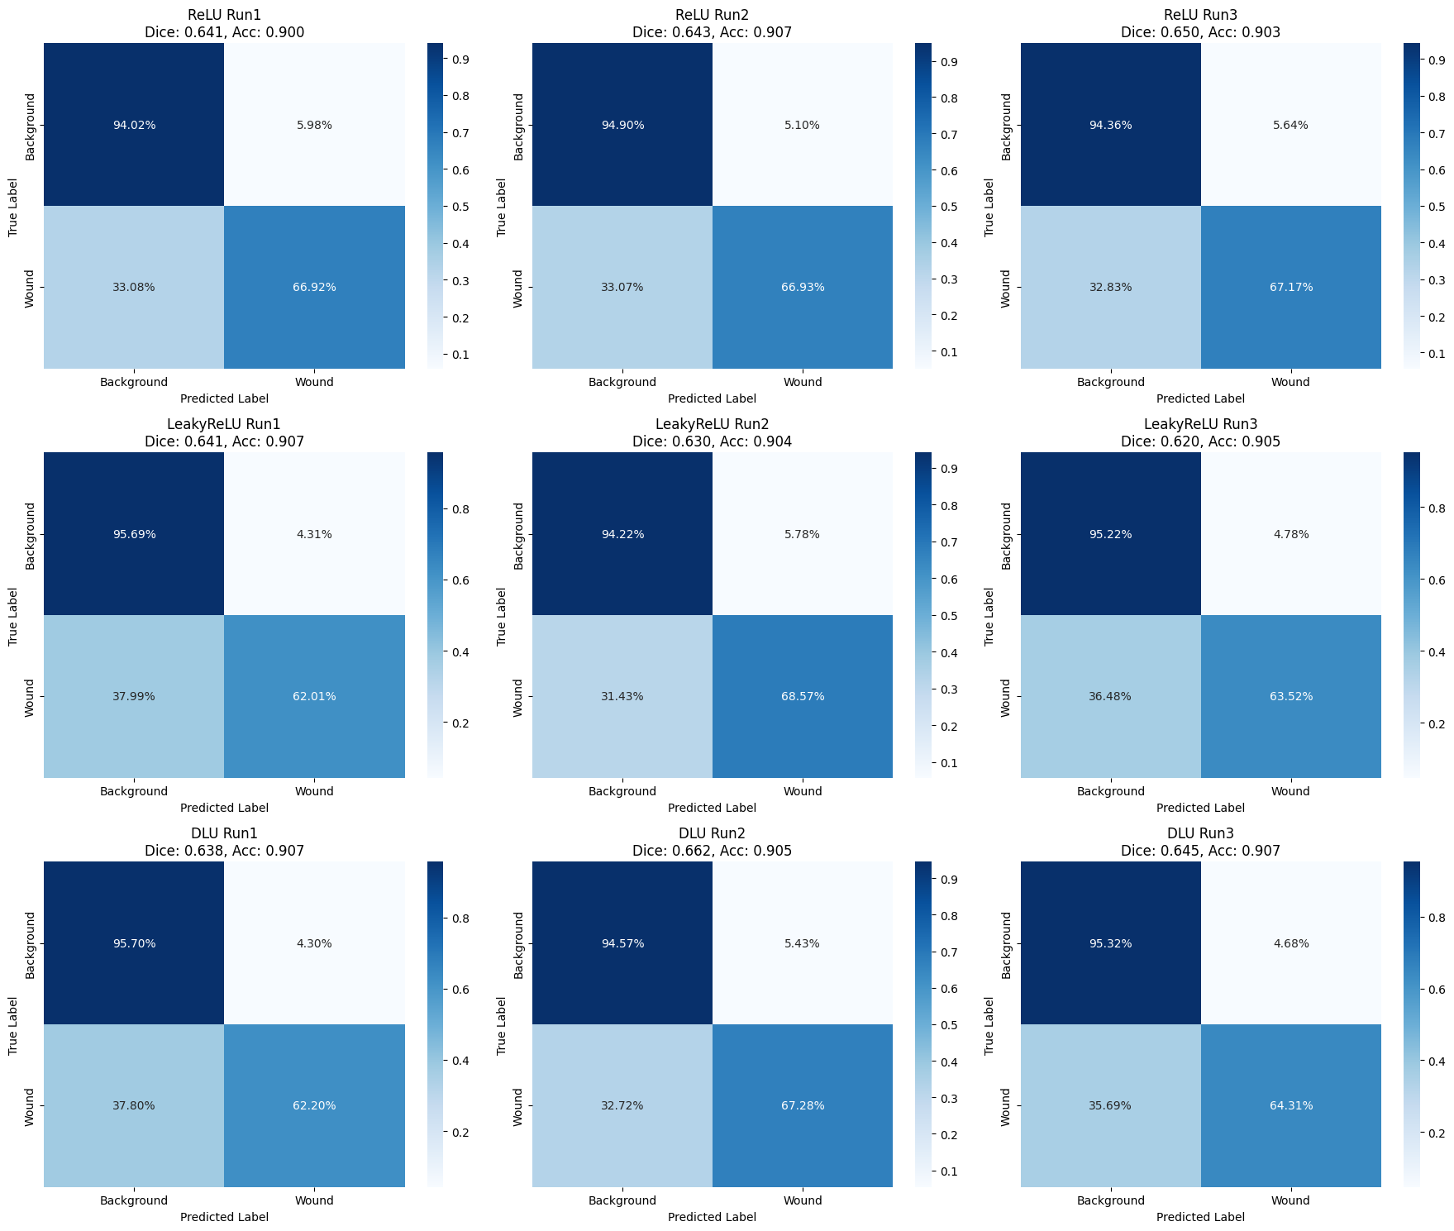
ReLU 3 Runs
LeakyReLU
3 Runs
DLU 3 Runs

Slide 7
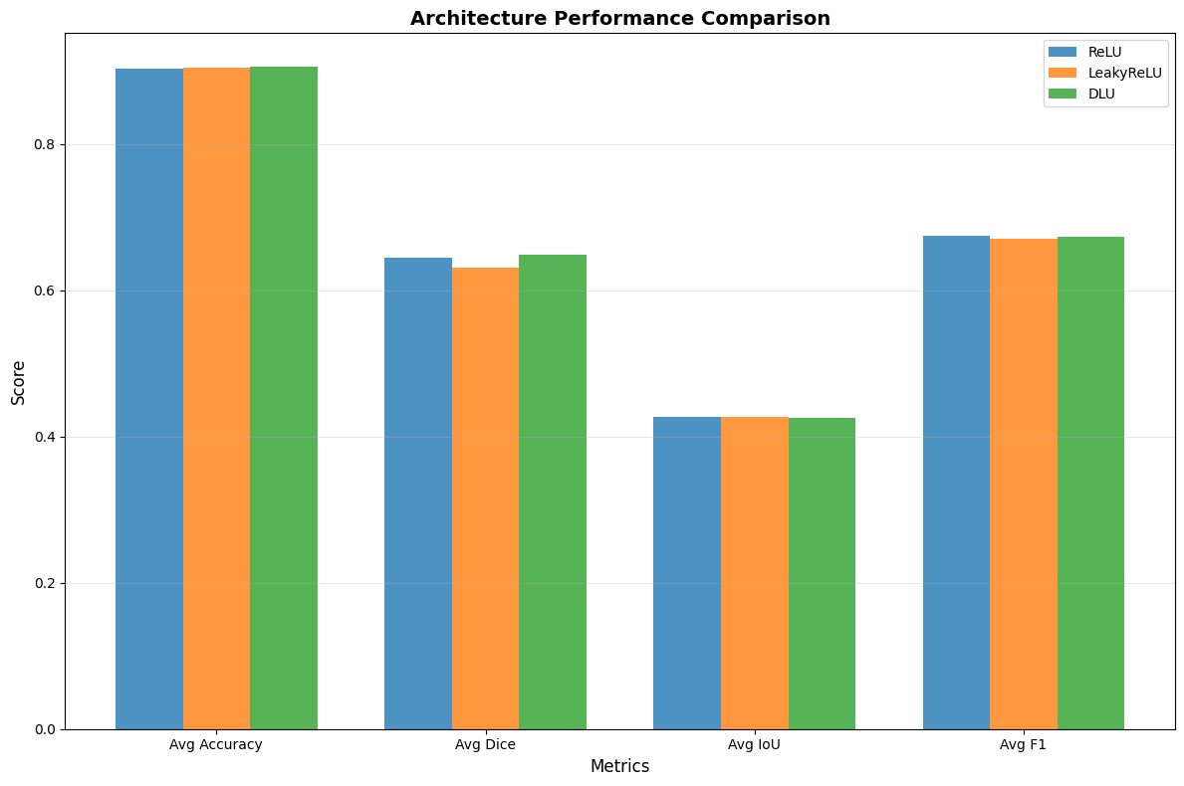

Slide 8
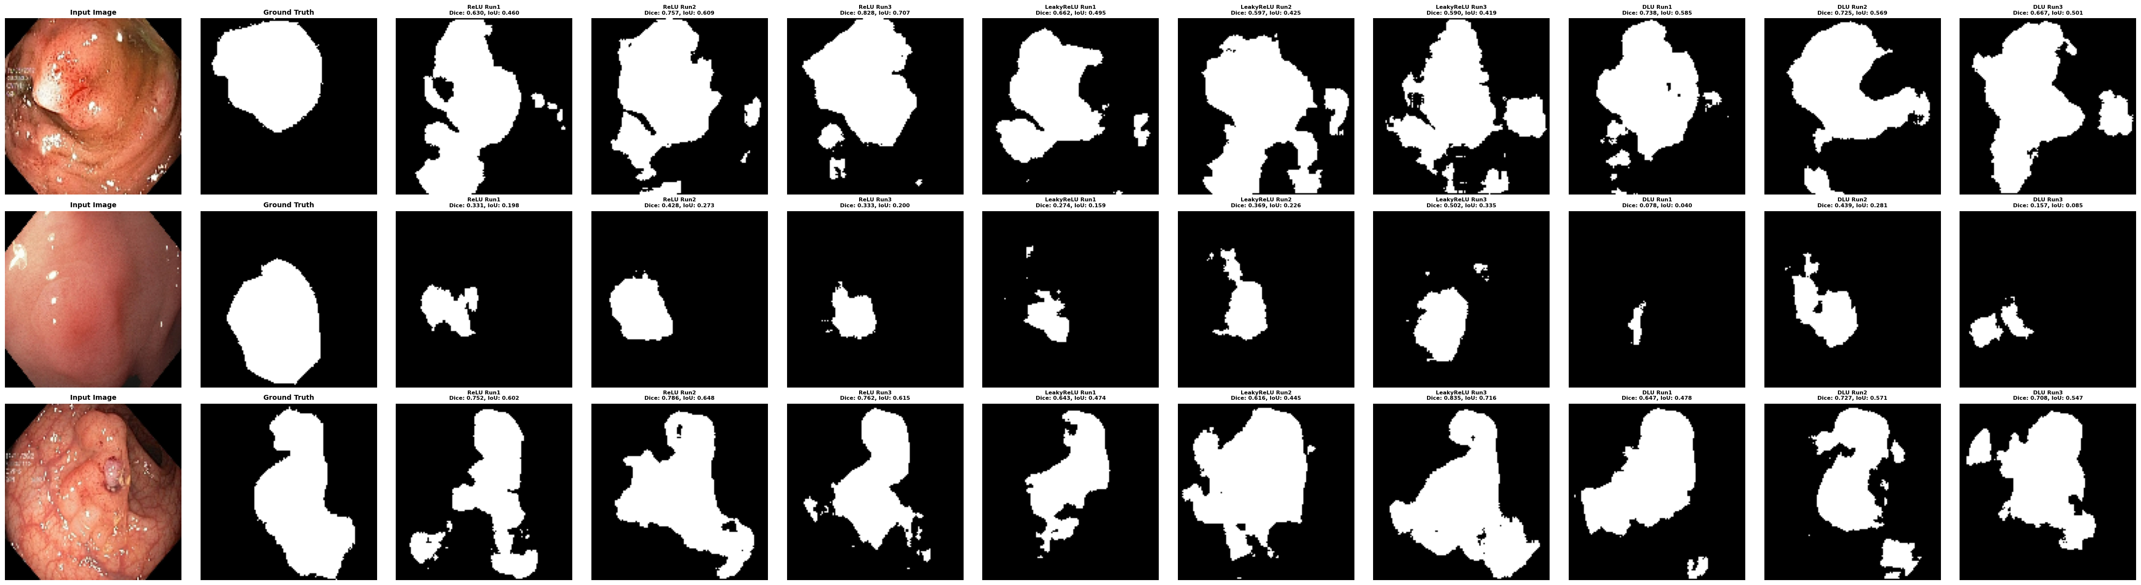
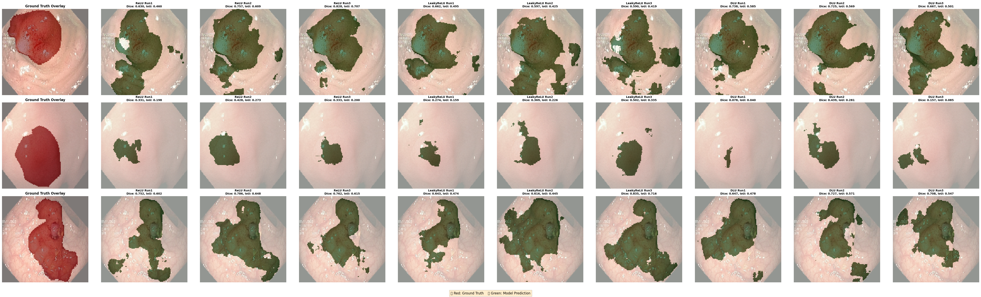
ReLU 3 Runs
LeakyReLU 3 Runs
DLU 3 Runs

Slide 9
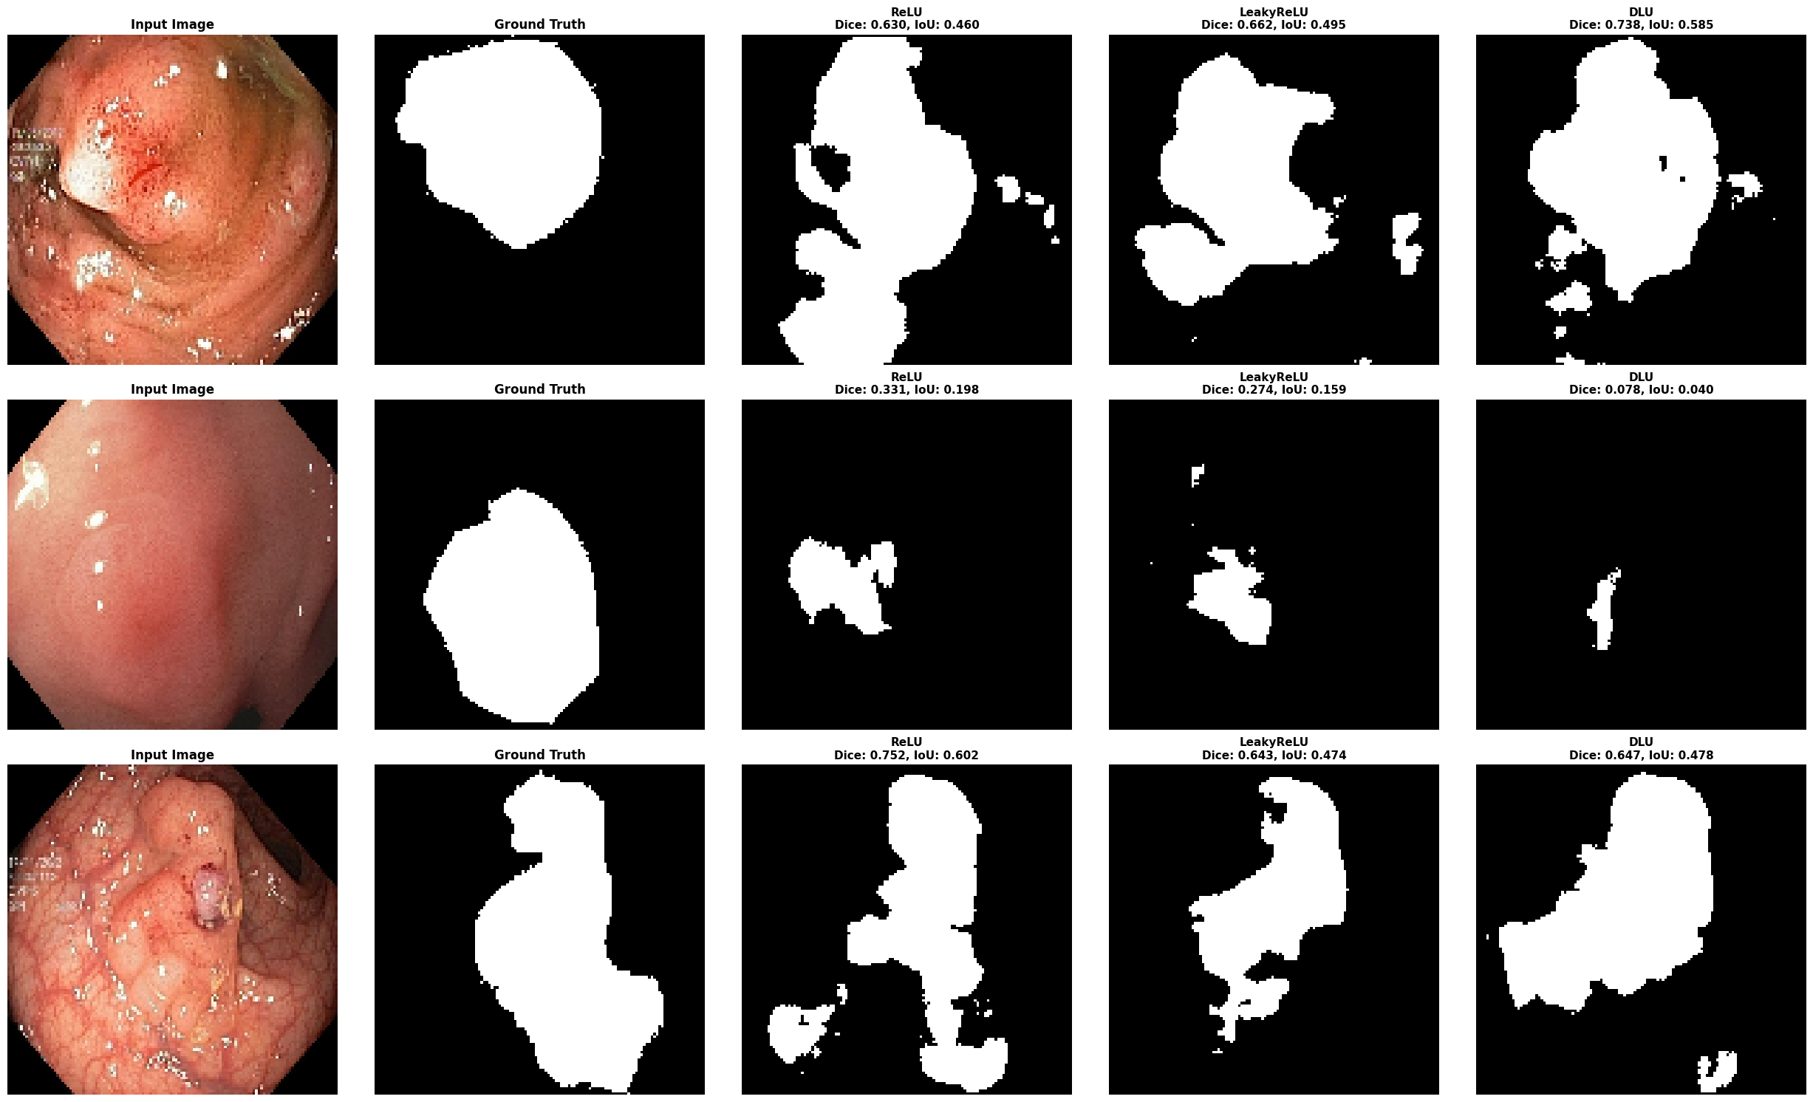
Image
Ground Truth
ReLU
LeakyReLU
DLU

